Slide 1
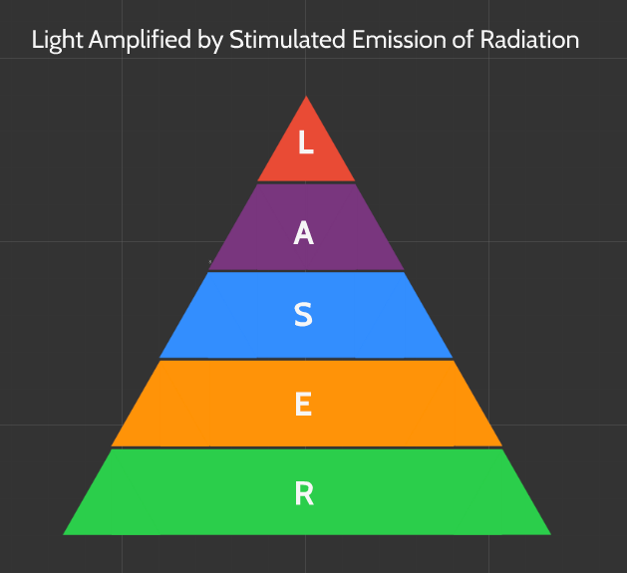
Course 1
What is a Laser?
Notes:
Medical lasers are medical devices that use precisely focused light sources to treat or remove tissues.The term “laser” stands for light amplification by stimulated emission of radiation. Ordinary light, such as that from a light bulb, has many wavelengths and spreads in all directions. Laser light, on the other hand, has a specific wavelength. It is focused in a narrow beam and creates a very high-intensity light. Because lasers can focus very accurately on tiny areas, they can be used for very precise surgical work or for cutting through tissue (in place of a scalpel).

Slide 2
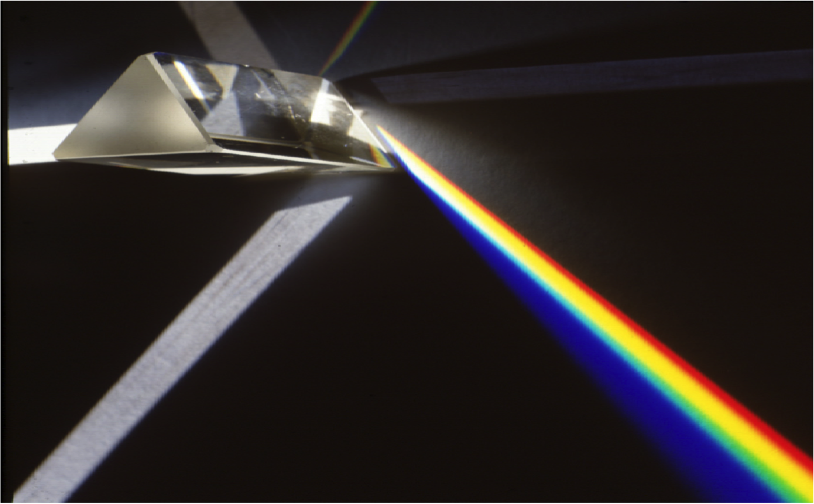
Light
Visible or Invisible
Notes:
a loose term used to include visible as well as invisible radiation (e.g. infrared).

Slide 3
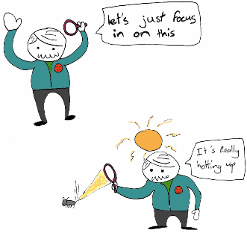
Amplified
Intense
Notes:
the increase in intensity of light.

Slide 4

by Stimulated
Energy Source (Electrical or Light)
Example: Flash Lamp or Laser to excite the Photons
Notes:
the physical process which produces the amplification.

Slide 5
Emission
Notes:
The reasion why a laser works

Slide 6
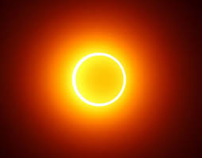
of Radiation
Notes:
a general term like "light"

Slide 7
Summary Slide
Notes:
Revise LASER anagram

